Slide 1
Using the FLDPLN Model for Flood Inundation Model
Introduction to the FLDPLN FIM model
Use Wildcat Creek, KS Labor Day flood event as an example
Workshop materials
Notebooks, Python packages and tools are on GitHub
https://github.com/XingongLi/fldpln
fldpln_py, MATLAB Runtime installer (without MATLAB Runtime), fldpln and ArcGIS toolbox
Wildcat Creek data is on KU KBS-KARS server
DEMs, segment shapefiles, gauge data and reference FIM map
Installer with MATLAB Runtime included on KU KBS-KARS server
About 6 hours

Slide 2
Low Complexity FIM Models
Hydrodynamic models are more accurate but need more data and computational resources
Low complexity models are faster and need few inputs
Faster at high resolution over large areas
Hydro-conditioned DEM as the primary input
Especially useful in predicting inundation extent and depth that are likely to occur in the immediate future using observed or forecasted stream stage

Slide 3
The FLDPLN (floodplain) Model
Low-complexity flood inundation model based on backfill and spillover flooding mechanisms
Backfill
Flooding
Spillover
Flooding
water surface
Q
P
flow
water surface
d
flow
ground surface
ground surface
uphill flow
(swelling)
downhill flow
(overland flow)
}
d
P
Q
“Water seeks its own level”
“Water flows downhill”

Slide 4
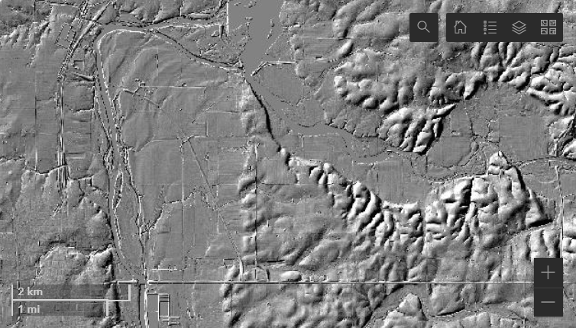
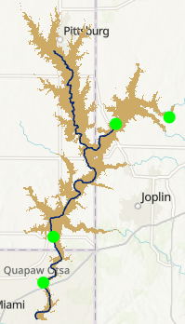
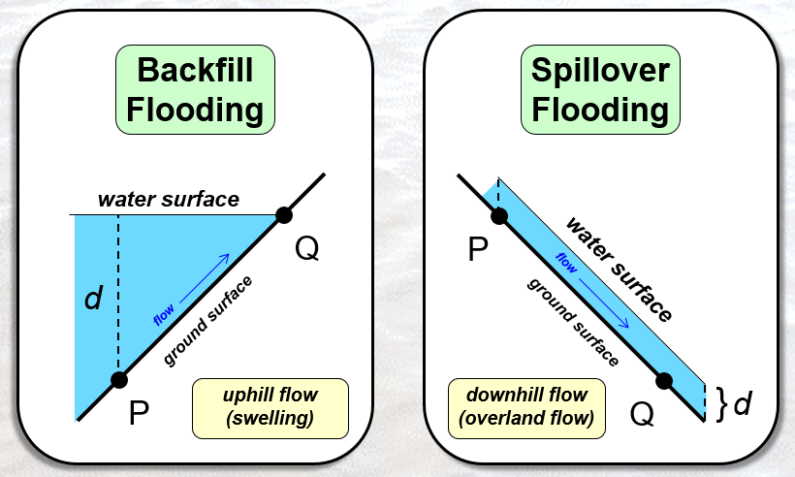
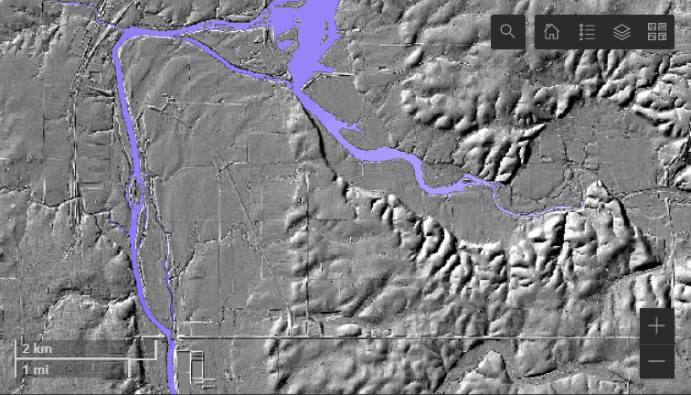
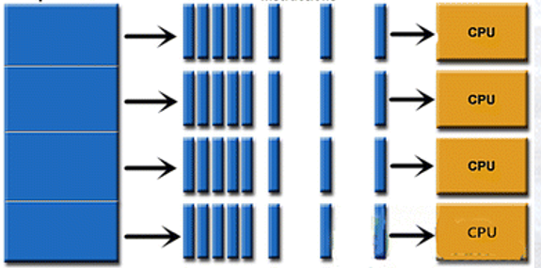
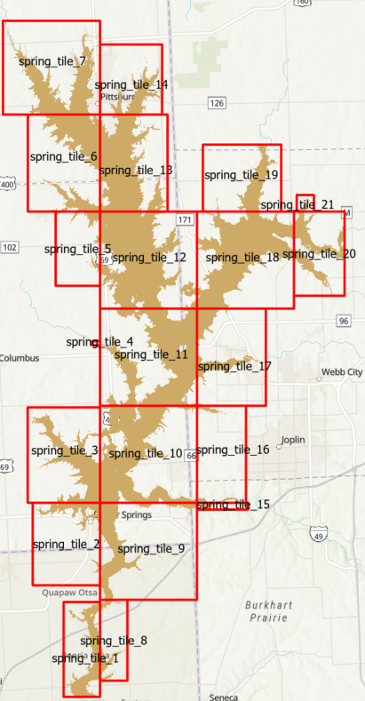
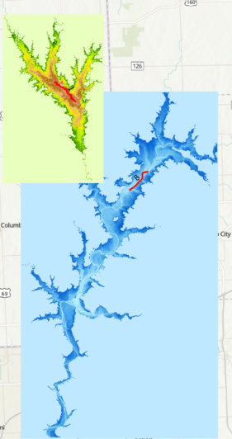
Major Processes
Hydro-conditioning DEM
FLDPLN inundation modeling
Segment to tiled libraries
Inundation mapping
FLDPLN

Slide 5
Hydro-Condition DEM
Processing of a DEM so that the flow of water is continuous across the terrain surface
Tools
GIS (ArcHydro) and special tools
Examples
Fill spurious sinks or pits
Add breach lines to drain sinks
Burning culverts into roads
Cut through bridges above river
Burning spillway into dam
Add flood defense (levees and flood walls) into DEM
Mask out large waterbodies

Slide 6
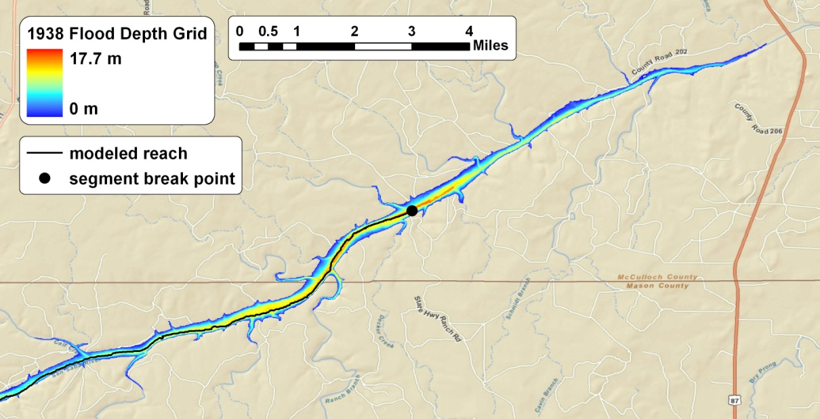
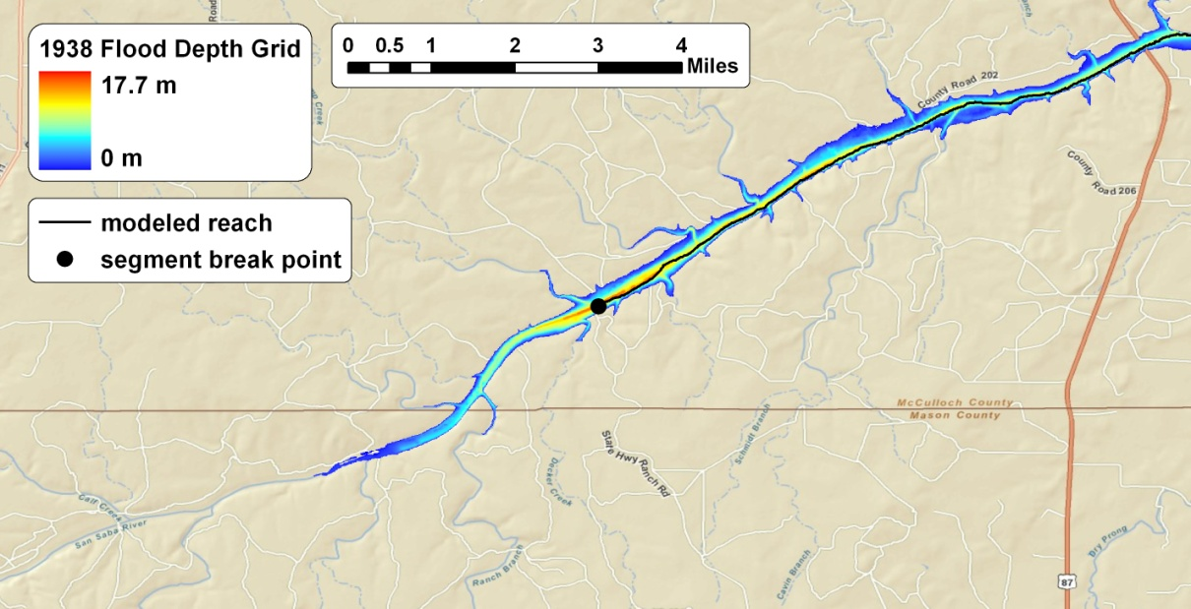
Segment-based modeling with FLDPLN
spillover taper
(depth decay)
upstream
segment
flow
downstream
segment
backfill taper
(lake effect)
flow

Slide 7
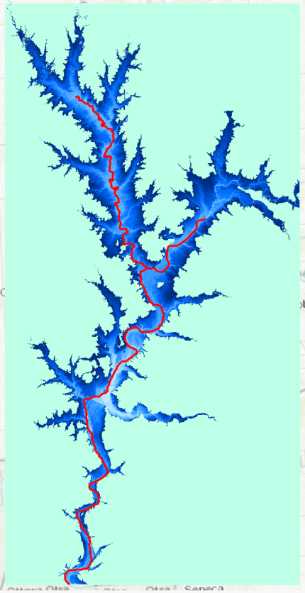
Flood Inundation Relations
A floodplain pixel (FPP) can be flooded by the water originated from flood source (stream) pixels (FSPs) through backfill and spillover flooding
FSP-FPP flood relation
many-to-many relation
Depth to flood (DTF)
Minimum depth at a FSP needed to flood a FPP
Attribute associated with a FSP-FPP relation
FLDPLN model identifies the FSP-FPP flooding relations and their associated DTFs
Iterative process
5
(DTF)
3
(FPP)
1
(FSP)

Slide 8
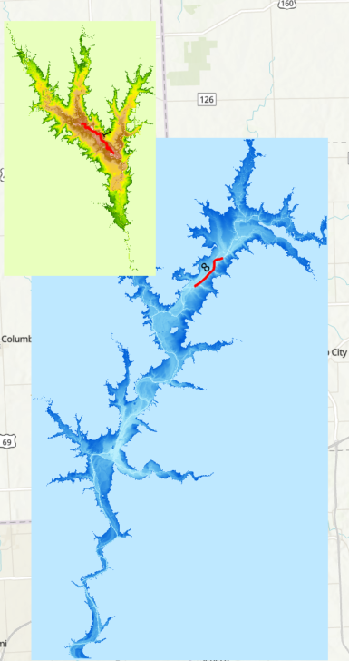
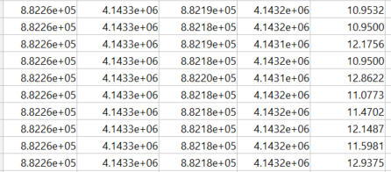
Tile FSP-FPP Inundation Relations
Organize relations by tiles
Each tile stores all the FSPs that can flood the FPPs in the tile
Flood mapping by tiles
Avoid memory overflow with a proper tile size
Only one file I/O is needed to map a tile
Scalable
Mapping tiles in parallel
Each tile can be mapped independently

Slide 9
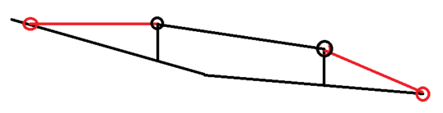
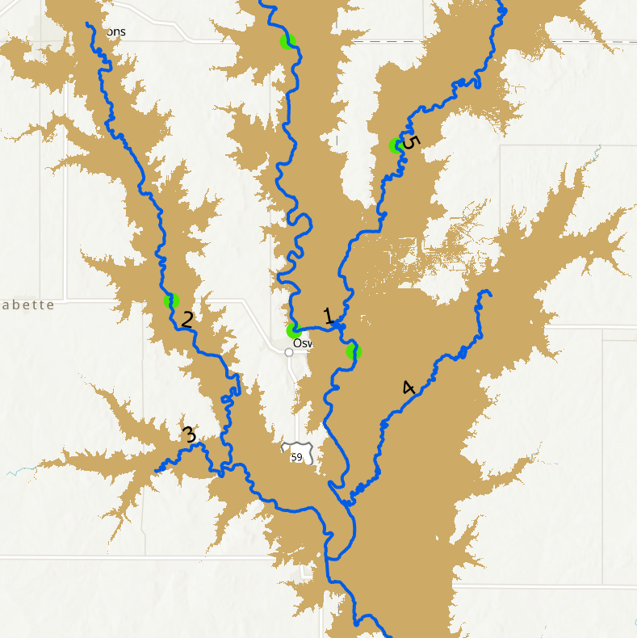
Flood Inundation Mapping
Estimate FSP depth of flow (DOF) from gauge observation or forecast
Snap gauges to FSPs
Based on steam orders
From low to high
Linear interpolation using
distance or elevation
Stage sources
NWS AHPS and USGS
NWM + HAND SRC

Slide 10
Inundation Mapping
Interpolated FSP DOF
A FPP is flooded by a FSP if its DOF > DTF
FloodDepth_{FSP(i)} = DOF_{FSP(i)} - DTF_{FSP(i)}
Flood depth at a FPP
max(FloodDepth_{FSP(1)}, …, FloodDepth_{FSP(n)})
N is the number of FSPs that flood the FPP
Example
Flood depth = max((5-3), (7-1)) = 6
3
5
3
5
1
7

Slide 11
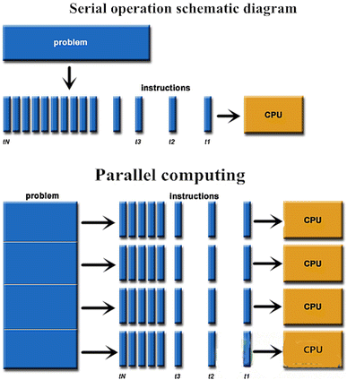

Parallel Inundation Mapping
Time sensitive application
Tiled libraries ready for parallelization
Dask with custom directed acyclic graph (DAG)

Slide 12
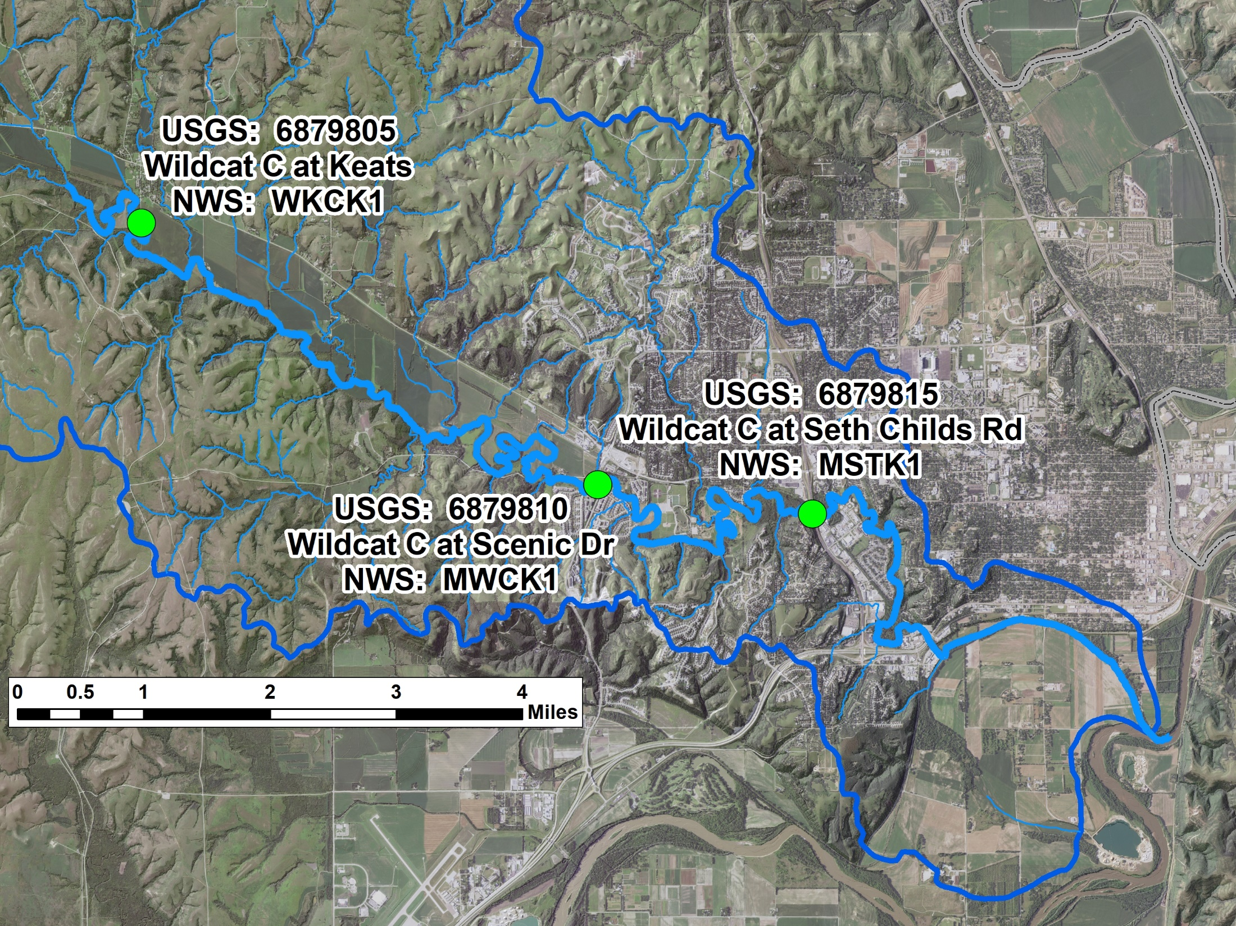
Mapping Sep. 3, 2018 Wildcat Creek Flood

Slide 13
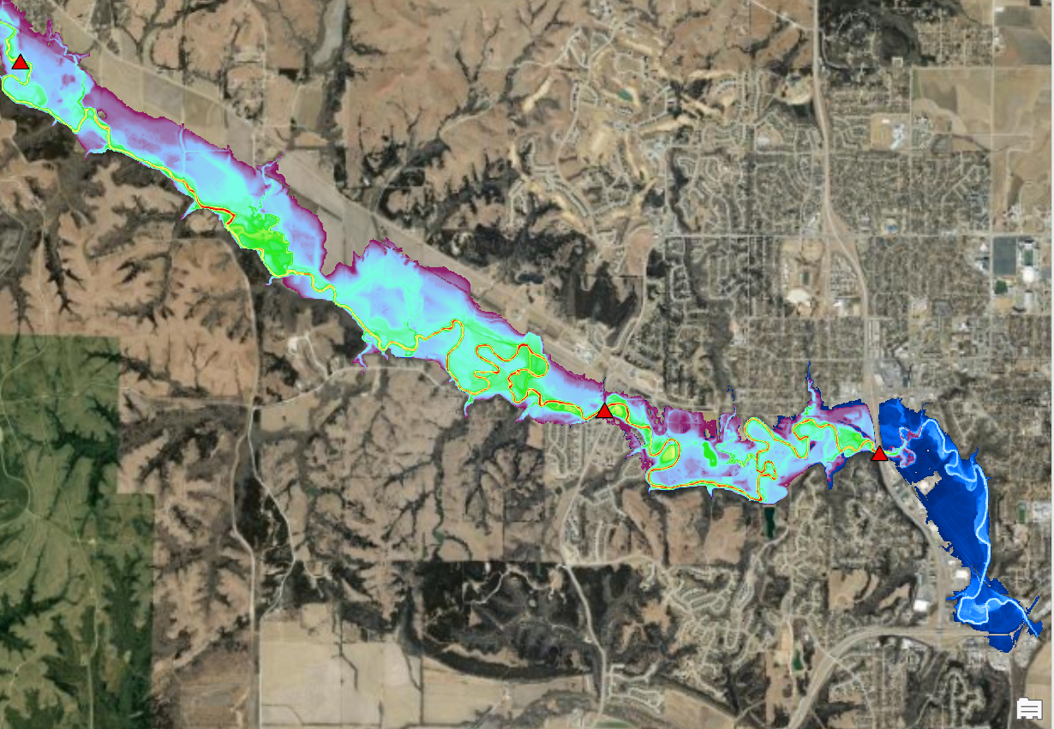
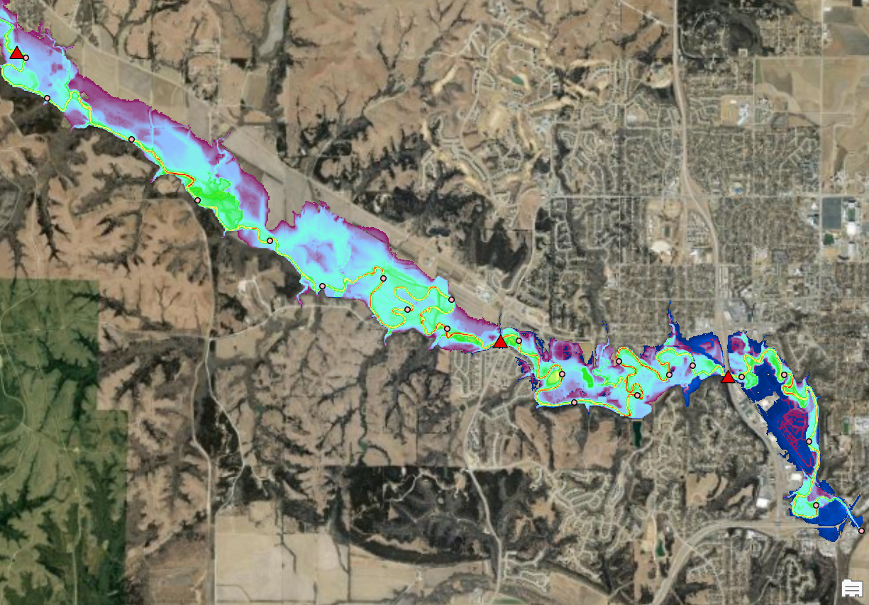
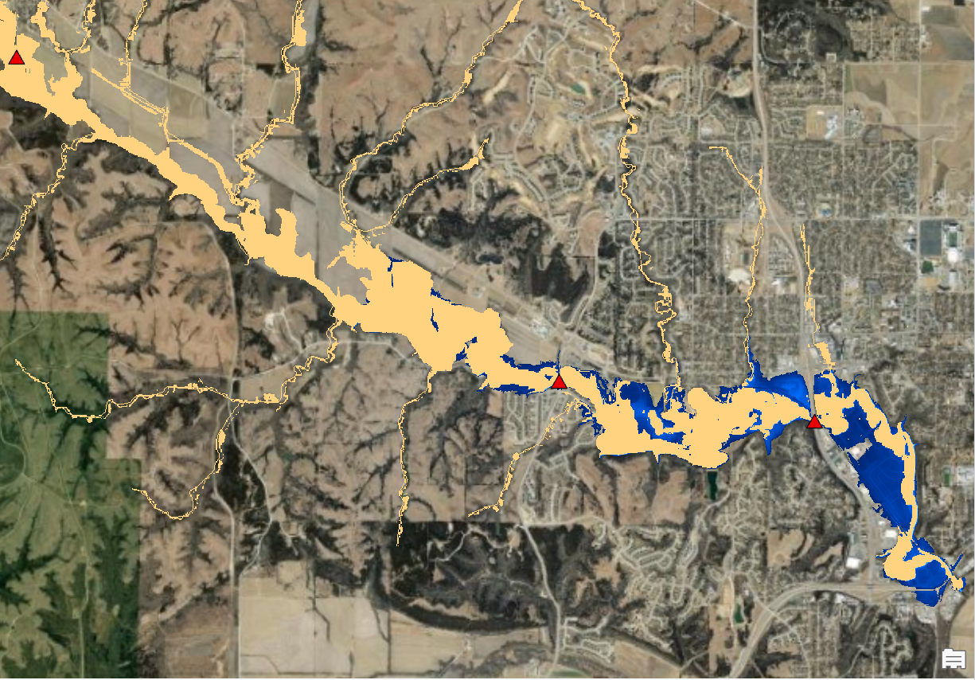
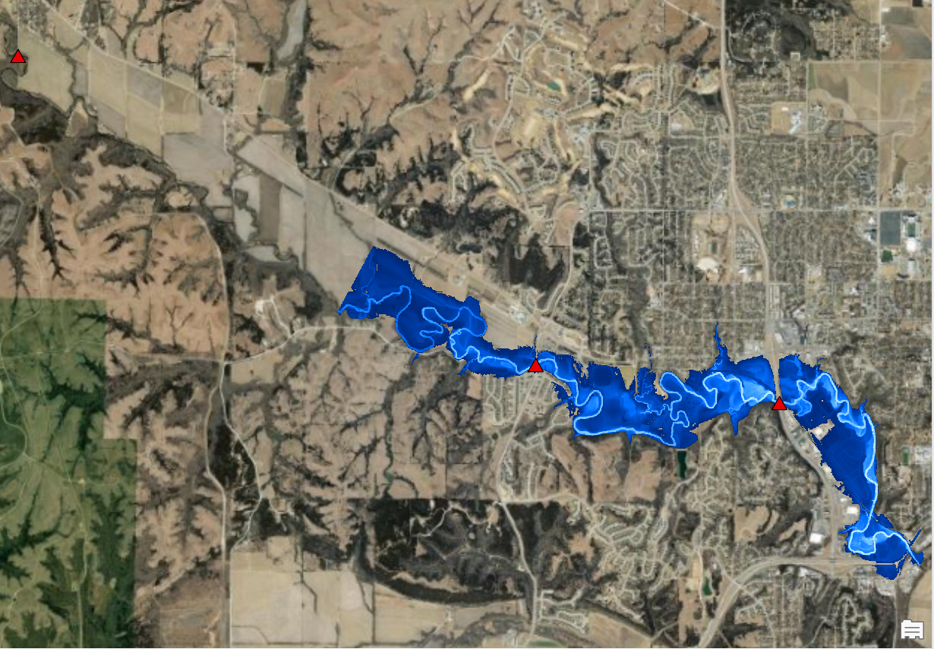
HAND and FLDPLN FIM with 10-m DEM

Slide 14
Mapping Wildcat Creek 2018 Labor Day Flood
Data in wildcat_10m_3dep.zip
DEM (GeoTIFF and BIL)
Event gauge data
Reference inundation map
Segment shapefiles
MATLAB Runtime and Python packages are only for Windows

Slide 15
Mapping Wildcat Creek 2018 Labor Day Flood
Hydro-condition DEM
No conditioning for the DEM
Convert hydro-conditioned DEM (in GeoTIFF) into BILs
ArcGIS toolbox fldpln preprocess model.atbx
fldpln_pre_process_tool tool

Slide 16
Mapping Wildcat Creek 2018 Labor Day Flood
mamba env create -f fldpln.yaml
Build a Python environment for FLDPLN
00_build_fldpln_python_env.md
Install miniconda
Install mamba in the base env
conda install -c conda-forge mamba
Create the fldpln environment using fldpln_windows.yaml
mamba env create -f fldpln_windows.yaml
Activate the fldpln environment
conda activate fldpln
Install additional packages for using the environment in JupyterLab or VSC
mamba install -c conda-forge jupyterlab

Slide 17
Mapping Wildcat Creek 2018 Labor Day Flood
mamba env create -f fldpln.yaml
Build a Python environment for FLDPLN
In the command window, navigate to the training folder and start JupyterLab from there
jupyter lab
Install fldpln_py
Run one of the two Windows installer
Locate where the fldpln_py is installed and activate fldpln env
Navigate to fldpln_py folder which has setup.py and use:
python setup.py install
pip install .
Install fldpln package
pip install fldpln

Slide 18
Mapping Wildcat Creek 2018 Labor Day Flood
Build segment-based library
01_build_segment_library.ipynb
Identify stream networks and generate segments (2 miles typically)
Select segments (16) for Wildcat Creek
Tile segment-based library
02_build_tiled_library.ipynb
For fast parallel mapping
Assign stream order for stage interpolation

Slide 19
Mapping Wildcat Creek 2018 Labor Day Flood
Create special maps
03_mapping_special.ipynb
Minimum DTF, # of FSPs, constant stage
Map inundation for flood events
04_mapping_event.ipynb
2018 Labor Day event
USGS/AHPS gauge stage
NWM + HAND SRC stage
Mapping by segment (for building new rating curve)
05_mapping_segment.ipynb

Slide 20
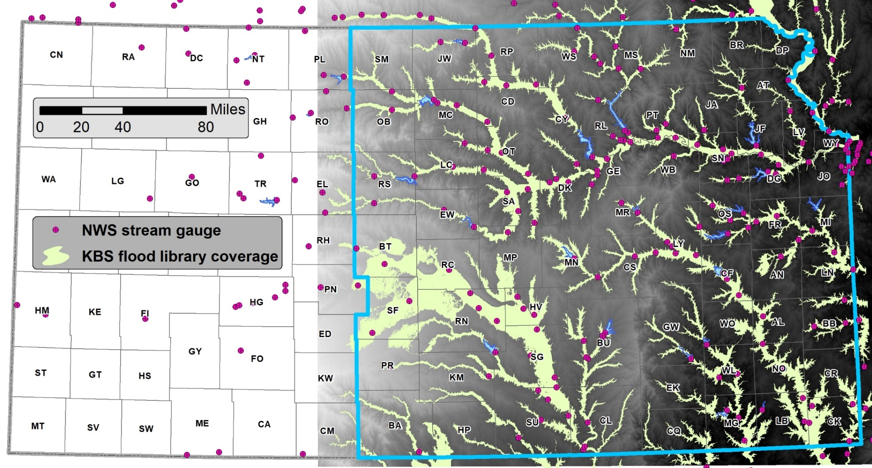
Old Libraries (25) with 5-m DEM

Slide 21
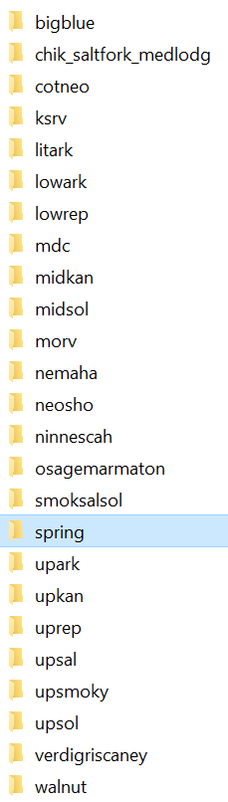
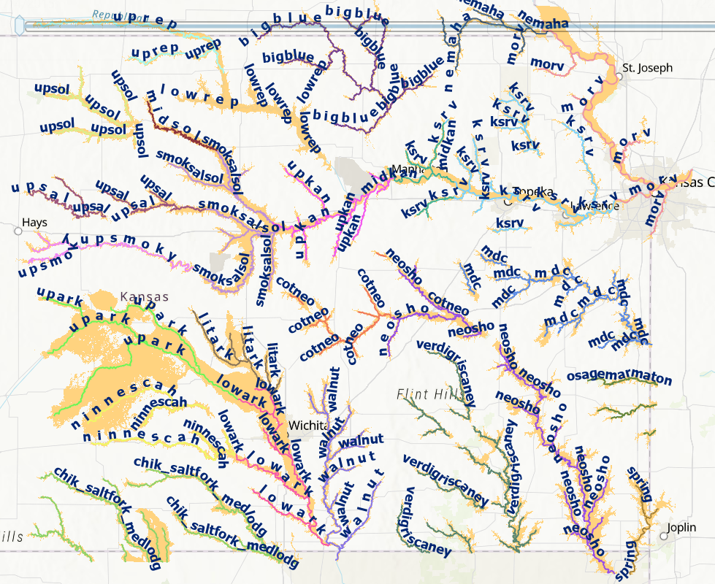

Slide 22
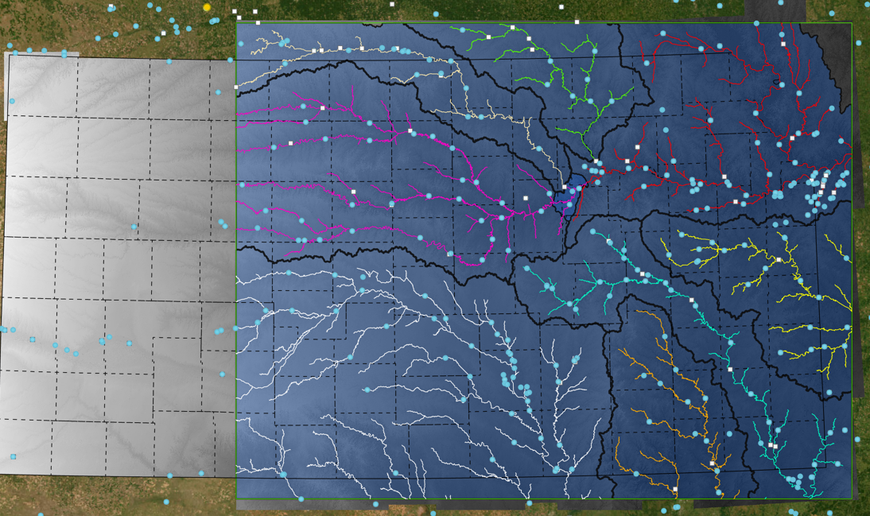
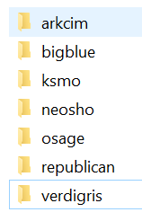
New Libraries (8) with New 5-m DEM

Slide 23
Changing Libraries and Code
Model is currently run for 8 libraries
Segment-based libraries are almost done
Code
MATLAB
Python
Both code has been changed for new libraries

Slide 24
Future Plan
FLDPLN model component
Support both Windows & Unix
YAML file for each OS
fldpln_py for each OS
Python class wrapper for fldpln_py
Hide data conversion from user
Make it available and installable from GitHub
Turn it into PyPI package
Re-implement it in Python?
FLDPLN mapping component
docstrings for the functions
Automatic stream order assignment
Turn it into a PyPI package

Slide 25
Acknowledgements
Jude and graduate students @KU
James and Junho @UA
Funding
GIS-PB
Kansas Water Office (KWO) / KDEM

Slide 26
Questions?
Xingong Li
lixi@ku.edu

